Slide 1
High-rate data

Slide 2
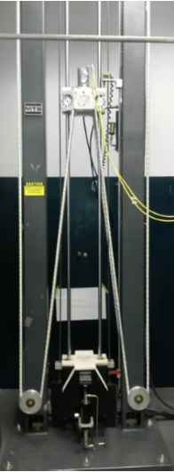
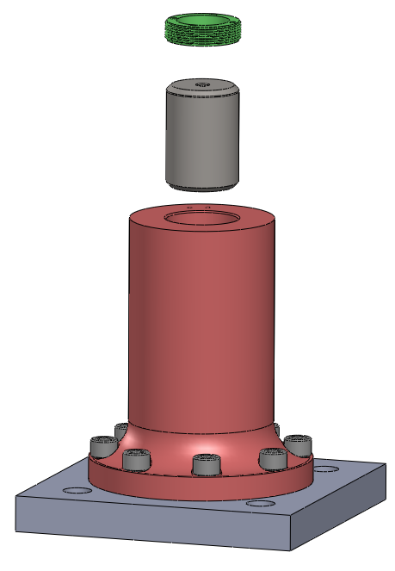
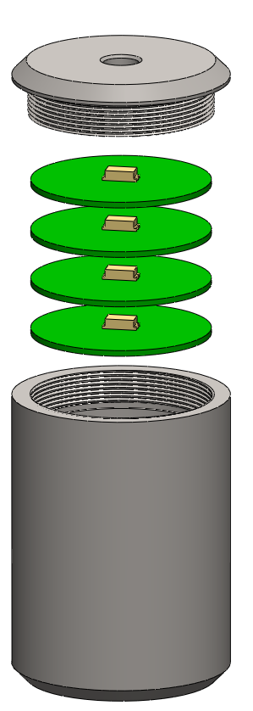
Experimental setup
a) drop tower; b) mounting fixture; c) electronics package
The units for the accels are in KGs. The sampling frequency is 1 MHz. Use below to create time vector.
N = length(accel1);
fs = 1e6;
dt = 1/Fs;
time = 0:dt:(N-1)*dt;
accel 4
accel 3
accel 2
accel 1
(a)
(b)
(c)

Slide 3
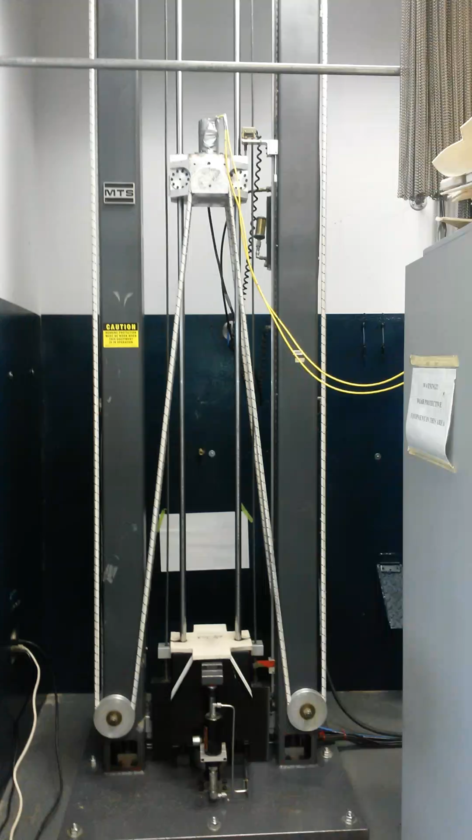
Video

